Slide 1
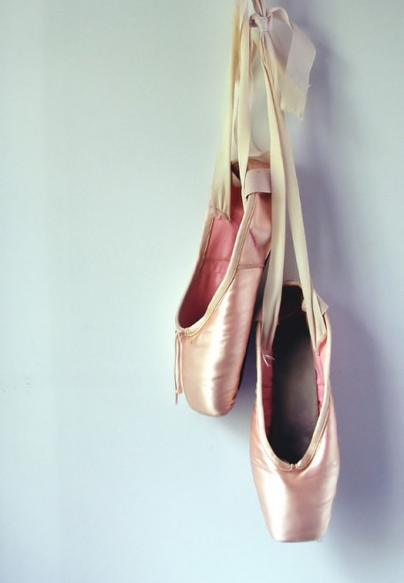

MCOSS2WED
Custom Fonts

Slide 2
Custom fonts
Two ways of adding custom fonts:
Download and reference locally
Reference a web font

Slide 3
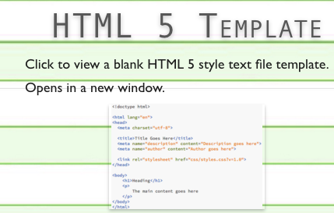
Task 1
Start a new HTML file using the HTML template - http://www.iteachit.net/reference
Create a blank CSS file
Add some text in an <h1> tag

Slide 4
Task 1
Web font

Slide 5
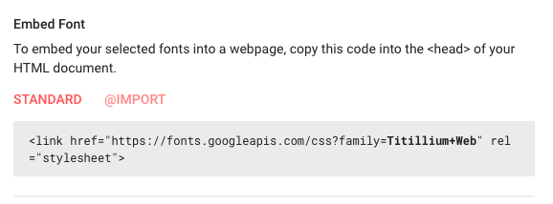
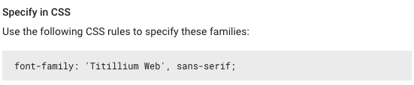
Task 1
Browse to https://fonts.google.com/
Choose a font you like
Add the font link to your HTML file in the <head> section
Specify the font-family in your CSS file for <h1>

Slide 6


Example code
HTML
CSS

Slide 7
Task 2
Local custom font

Slide 8
Task 2
Add another heading (<h2> this time) and type some text

Slide 9
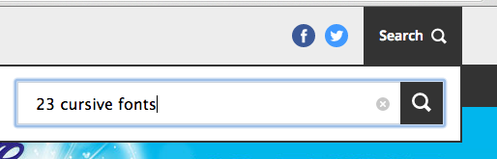
Task 2
Go to http://www.creativebloq.com
Use their search function to find ‘23 cursive fonts’

Slide 10
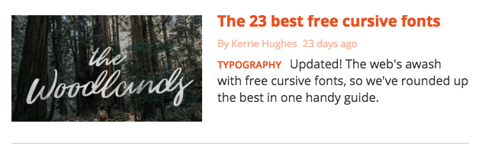
Task 2
Click on ‘The 23 best free cursive fonts’

Slide 11
Task 2
Download a font you like
Unzip it and copy it into a folder called ‘fonts’ in your web root
In your CSS file, add a section called @font-face:
@font-face {
}

Slide 12
Task 2
Specify the font-family and the location of the font file:
@font-face {
font-family: ‘KingBasil’;
src: url(‘/fonts/King-Basil-Lite.otf’);
}

Slide 13
Task 2
You should also specify the format of font (but if this stops your font working, remove this part):
@font-face {
font-family: ‘KingBasil’;
src: url(‘/fonts/King-Basil-Lite.otf’) format(‘truetype’);
}

Slide 14


Task 2
After the font-face section is added, you can use the font in your code:

Slide 15
What is an em?
You may have noticed that the font size can be specified in pixels and ‘em’s
What is an ‘em’?

Slide 16
What is an em?
An em is a unit of measurement used in design and typesetting
‘em’ refers to the dimensions of the letter ‘M’
It is commonly used in web design to specify relative font sizes

Slide 17

Task 3
Add a body section to your CSS
Add font-size: 20 to the body section
Choose a font if you like

Slide 18
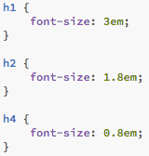
Task 3
Add these sections to your CSS:

Slide 19

Task 3
Make sure you have a body section and <h1>, <h2>, <h3> and <h4> sections in your HTML file

Slide 20
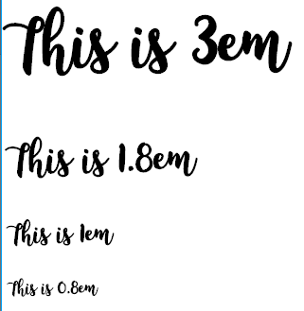
Task 3
Your webpage should look something like this:

Slide 21
Task 3
Try changing the font size in the body section of your CSS file. You should see ALL of your element’s font sizes alter proportionately.

Slide 22
em summary
When using using ems, the font size is proportionate to the font size of the parent element (in this case, the body).
If the parent element font-size changes, so will the child sections that are using ‘em’ font sizes.
Notice that we didn’t need to specify a font size for <h3>. It was taken from the body as it was set to 1em which will be the same size.

